Slide 1

Bottle Rockets Day 2
MIT STEAM Camp 2019

Slide 2
Rockets
Rockets help propel things and transport items to space
Since the launch of Sputnik, October 4, 1957, over 8000 objects have been launched into space
These satellites help provide cell phone communication, GPS, weather, and satellite television
Notes:
Yesterday I talked to about the first ancient rockets were used to propel arrows. The first rocket which actually launched something into space was used to launch Sputnik, the first satellite, on October 4, 1957. Since then, over 8000 objects have been launched into space. These satellites are what give us, cellphone communication, GPS, weather, and satellite television”

Slide 3
Payload
Payload is the carrying capacity of an aircraft or launch vehicle, usually measured in terms of weight
Can be a variety of items
Satellite
Space Probe
Spacecraft Carrying Humans
Animals
Cargo

Slide 4
Stomp Rocket with Payload
After watching the demonstration, what is the cause of the separation of the two parts?
Work in pairs to create a rocket with a payload.
Decide payload
Aluminum foil
Tape
Paper
Add picture of the w/ payload setup

Slide 5
Stomp Rocket with Payload
What worked well?
What was unexpected?
What would you change if you could do it over again?

Slide 6
Bottle Rockets with Payload
Work in pairs to design a bottle rocket that will transport the water balloon payload the farthest.
Add picture of the bottle rocket w/ payload setup

Slide 7
Bottle Rockets with Payload
What worked well?
What was unexpected?
What would you change if you could do it over again?

Slide 8
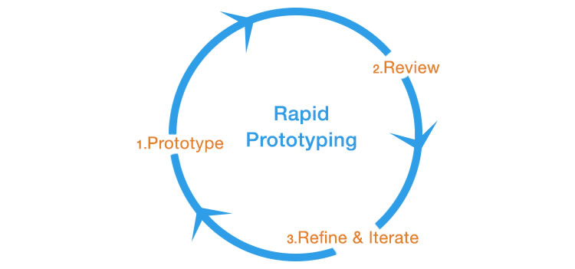
Iterative Design Process
Notes:
Have Been following the design process. Each time we build and test a rocket we use that knowledge to build a better rocket.

